Slide 1

PASSWORD PROTECTED PERSONAL DIARY
Presented By :
Group Id –BE2020A11.
1. Sharvari Birute.
2. Chetana Mahajan.
3.Hemal Sawdekar.

Slide 2
ABSTRACT
Password protected personal diary is a console application without graphics. In this project, user can keep their
personal record like they do in a diary. You can keep records of important things you do in your daily life, like meetings and various other tasks.
You can organize your schedule as well as view some particular entry of a particular date or time. In this console application, you can add, view, edit and delete records. Records can be added with information such as duration of task, name, address, time and date.

Slide 3

INTRODUCTION
Personal Diary Management System is based on concept to generate Personal Daily Records and to add records & update it.
The basic user-defined functions used in this project are listed below:
1. int password() – contains/manages/handles password protection
2.void add_record() – to add a new diary record
3. void view_record() – to view added record in list
4. void modify_record() – to modify and update an added record
5. void edit_password() – to modify/change a password
6. void delete_record() – to delete or remove a record permanently from system file

Slide 4
OOP CONCEPTS USED

Slide 5
FEATURES
The most important feature is that it is password protected .this program is also capable of changing the password as many times as you can.
The user can also take a look on this record.
The user can also make changes in the record.
The user has a power of deleting any record.

Slide 6
Software Requirement:
Windows 7
Visual Studio 2018
C#.Net
SQL2008
Hardware Requirement:
Core 2 Duo System
500GB HDD
1GB RAM

Slide 7
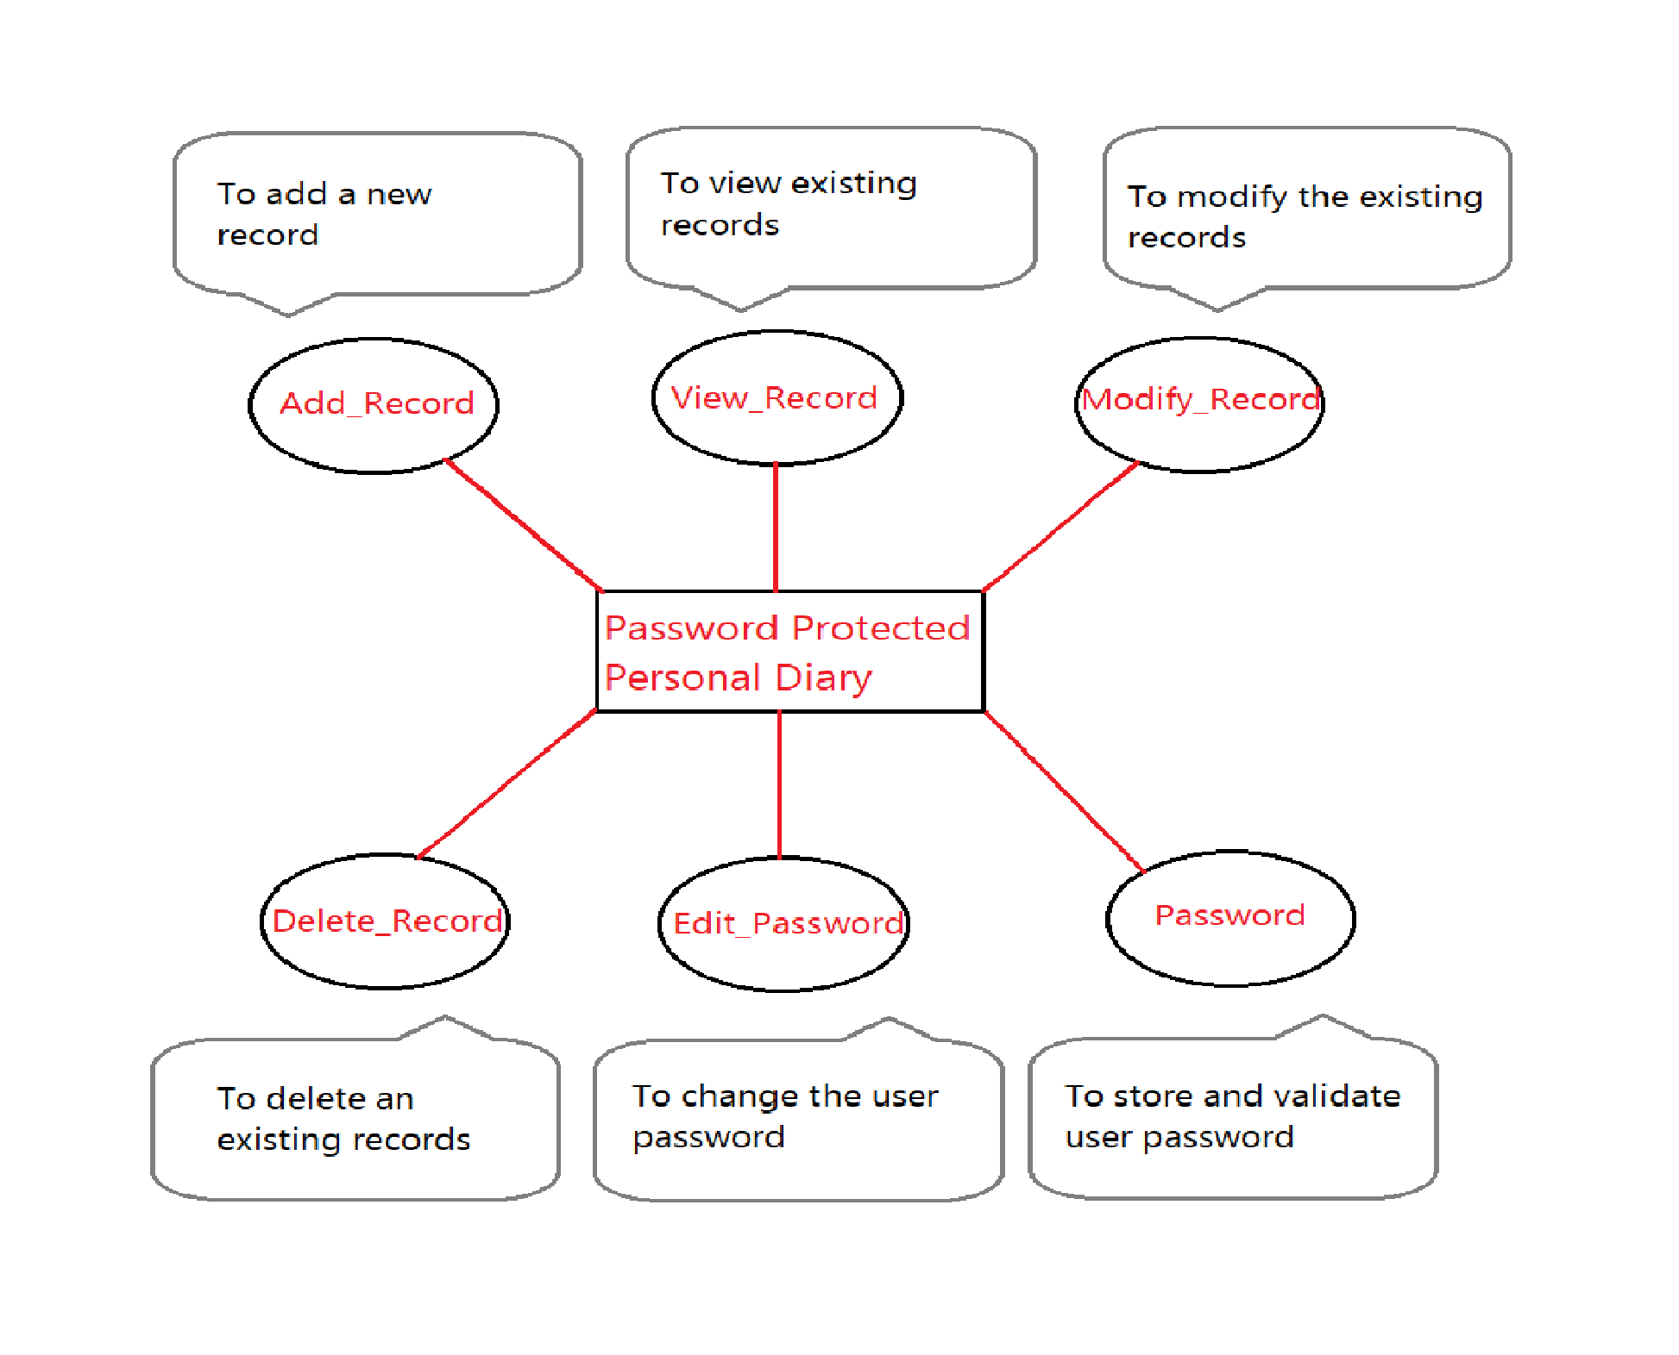
INTRODUCTION

Slide 8
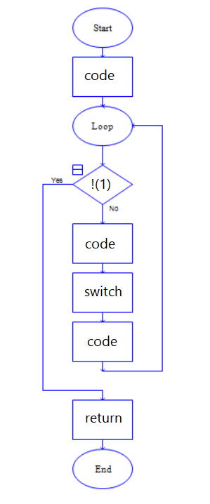
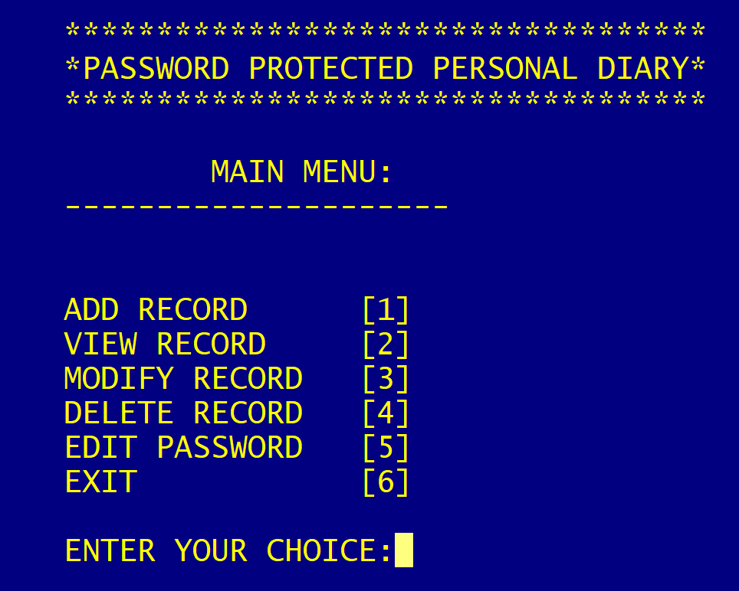
INT MAIN()
INT MAIN()

Slide 9
INT PASSWORD()
INTRODUCTION
It manages
password
protection and
returns 0
if the typed
password is
correct , else
it returns 1.

Slide 10
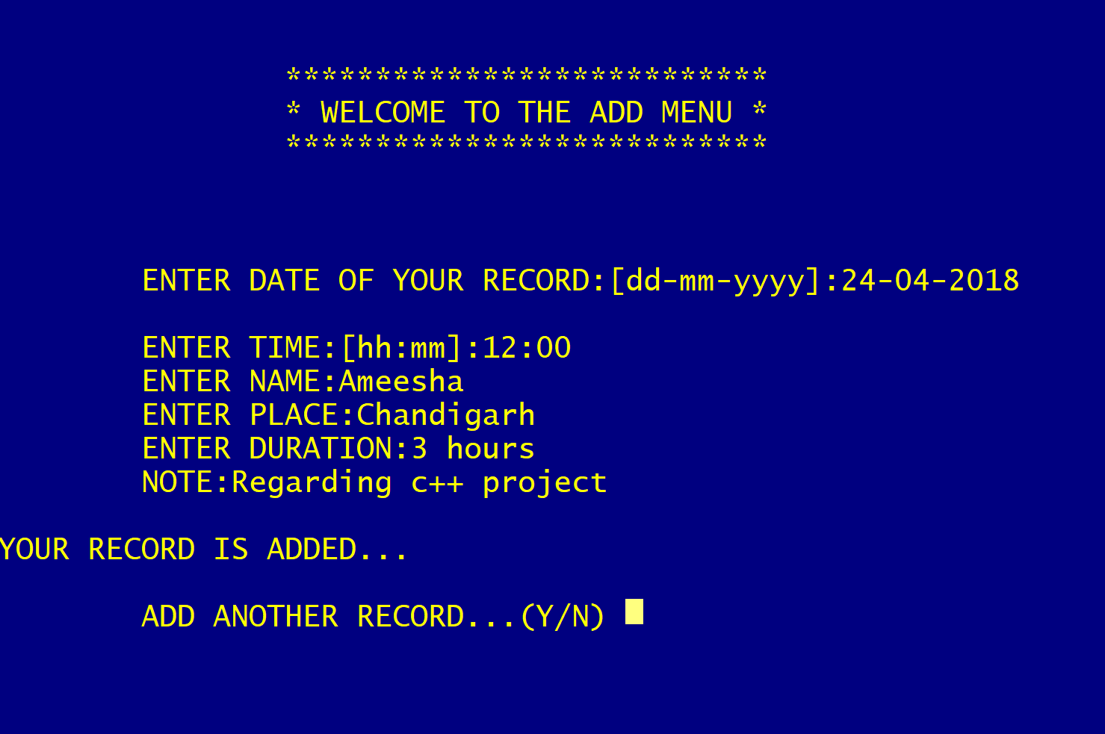
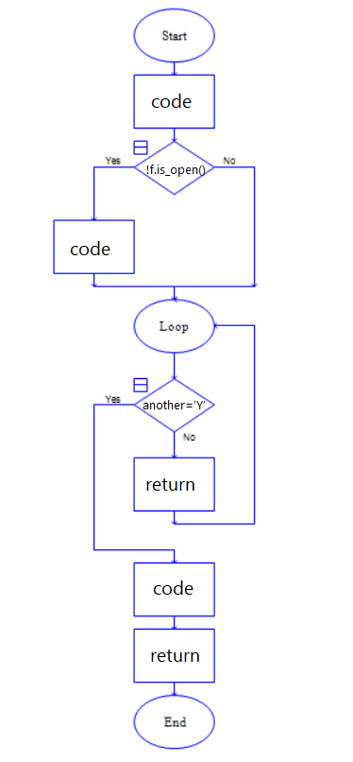
VOID ADD_RECORD()
INTRODUCTION
return

Slide 11
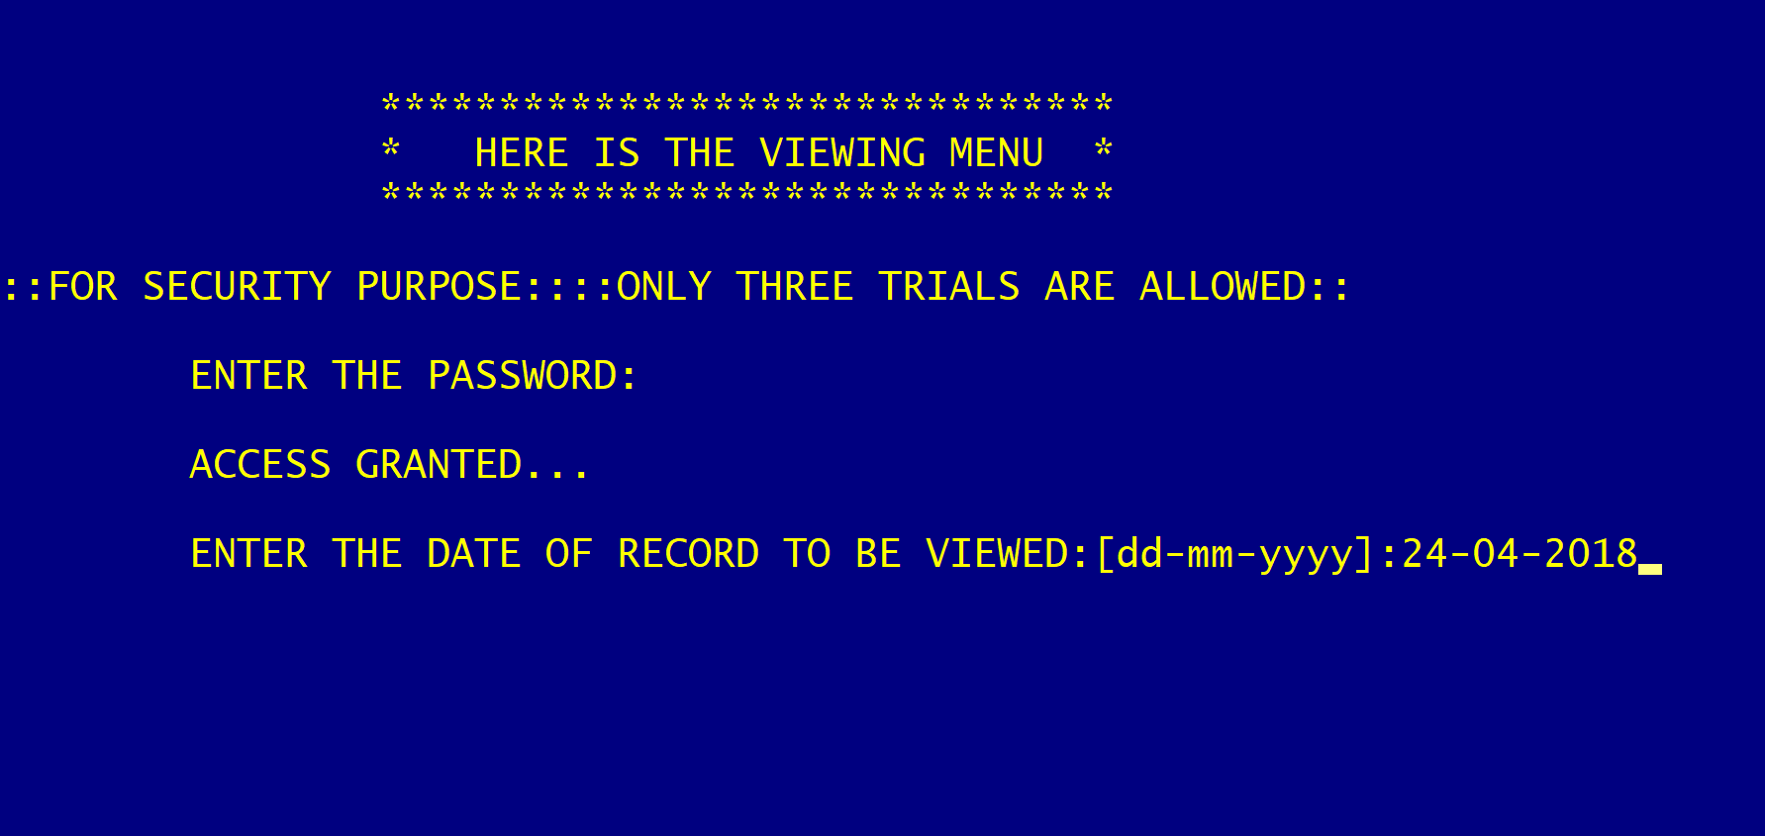
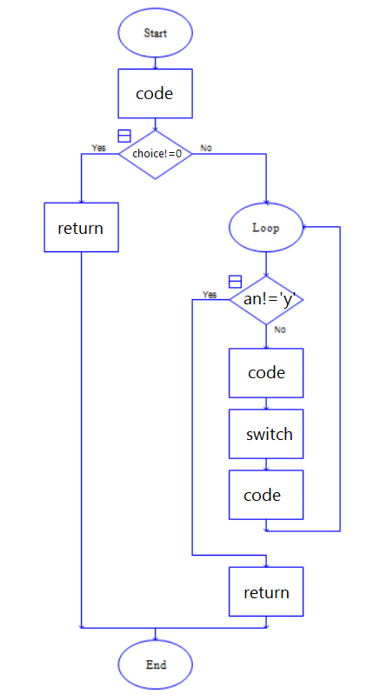
VOID VIEW_RECORD()
INTRODUCTION

Slide 12
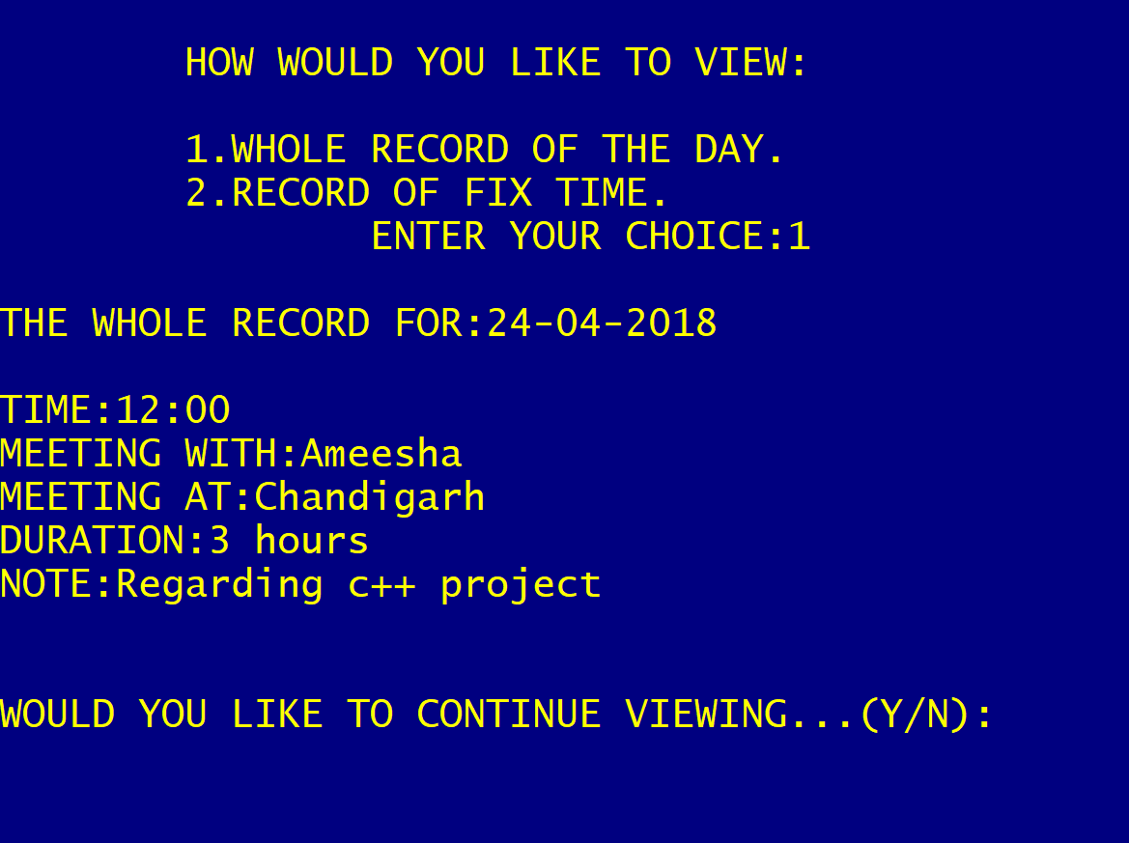
VOID VIEW_RECORD()
INTRODUCTION

Slide 13
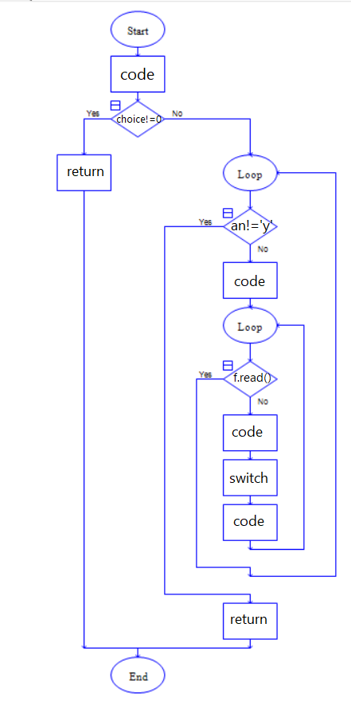
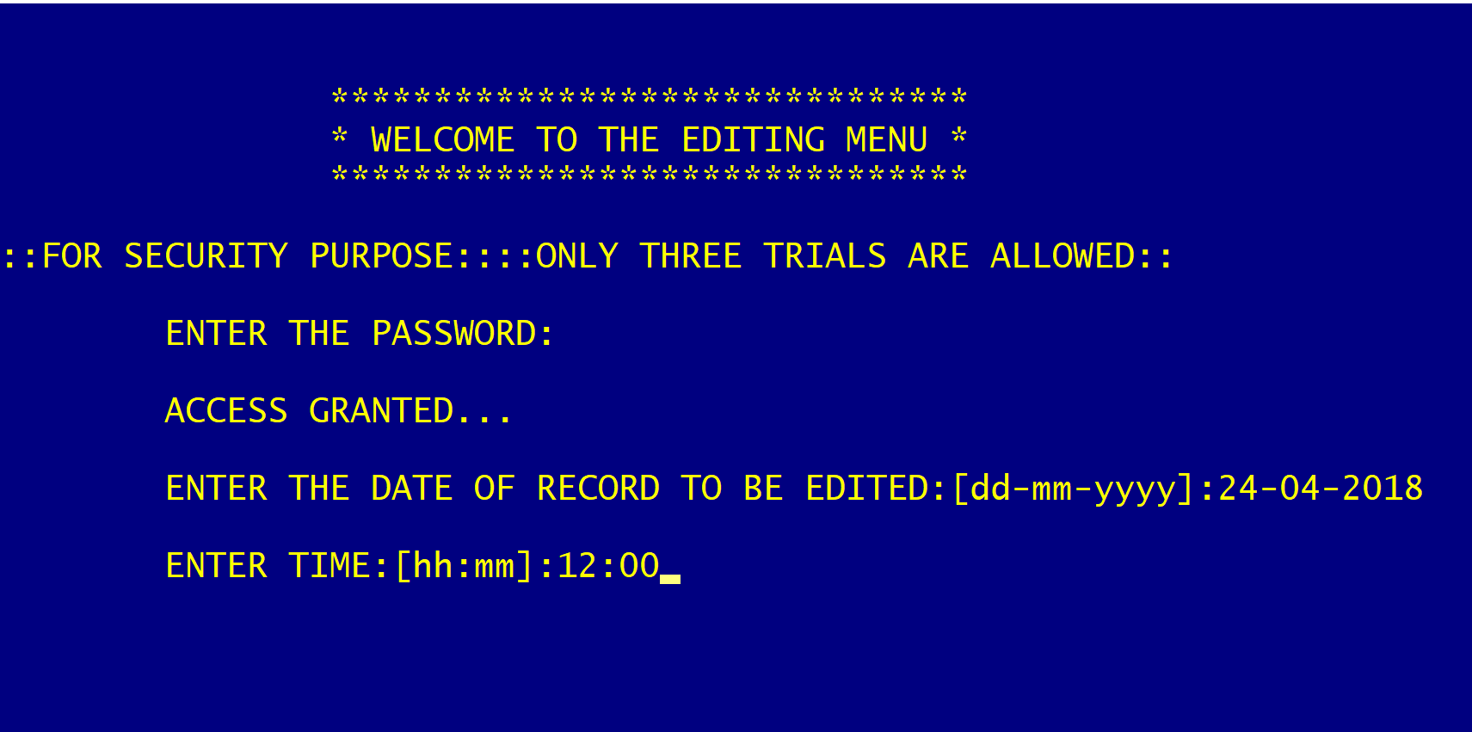
VOID MODIFY_RECORD()
INTRODUCTION

Slide 14
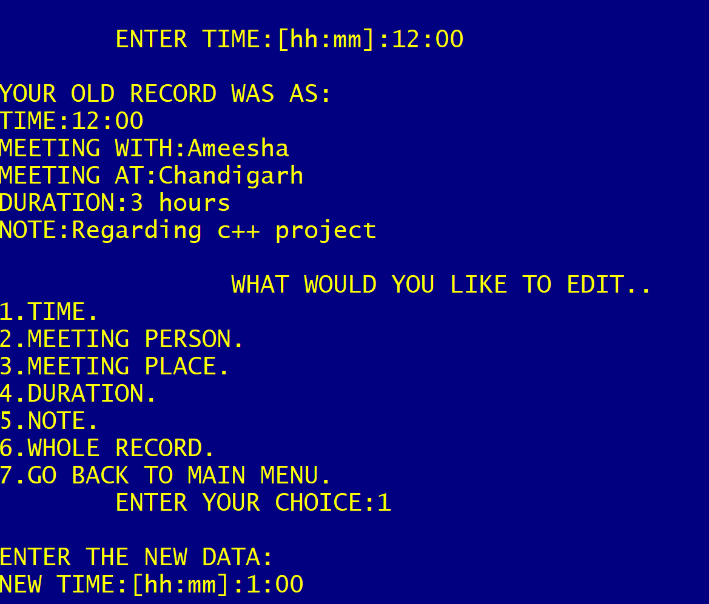
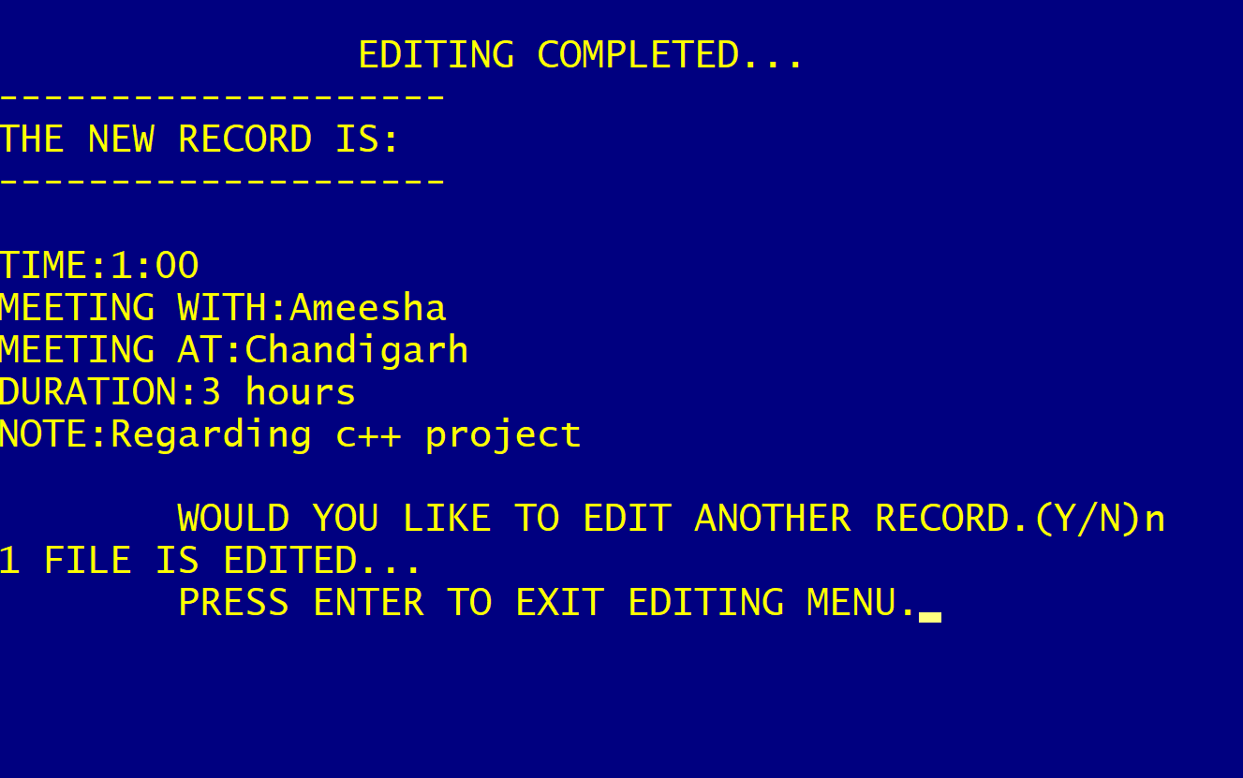
VOID MODIFY_RECORD()
INTRODUCTION

Slide 15
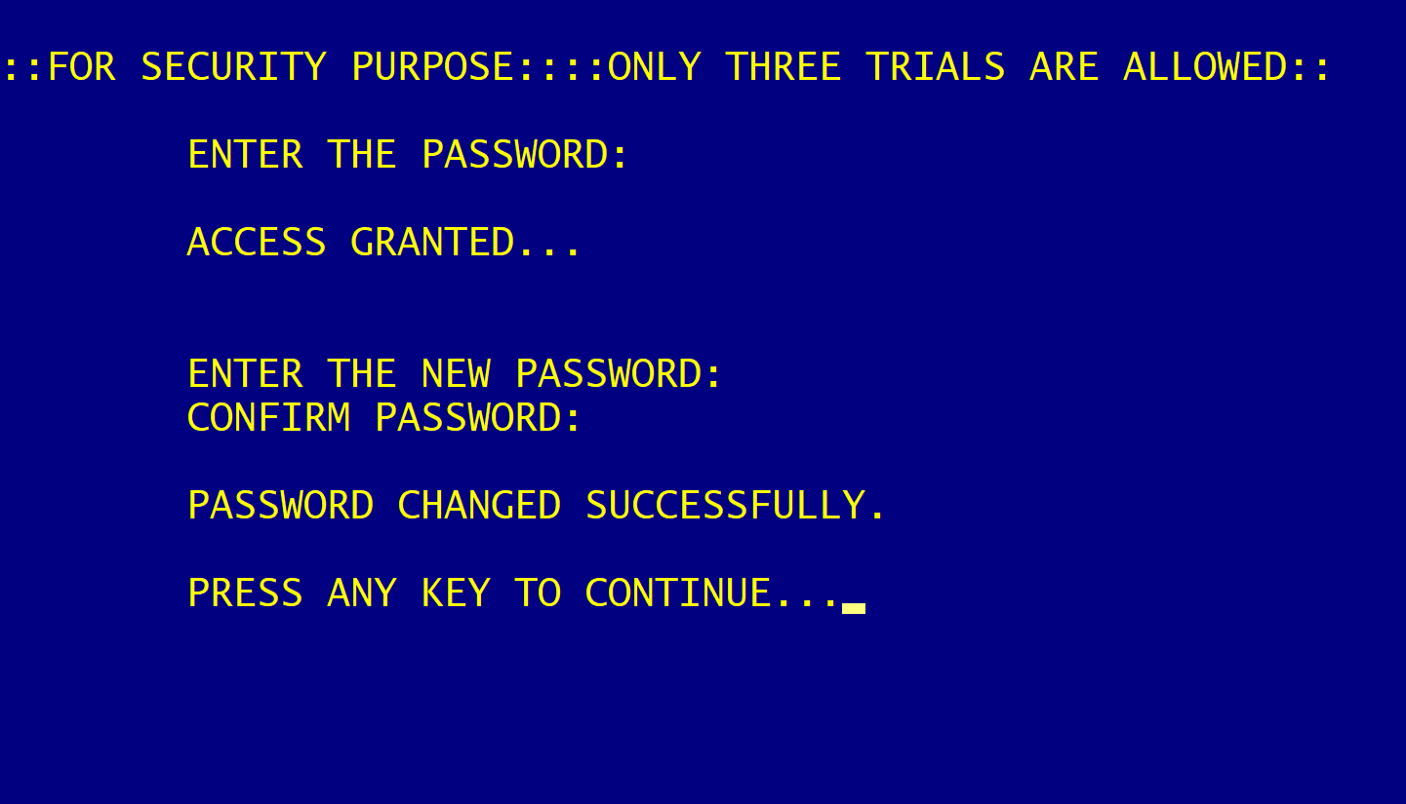
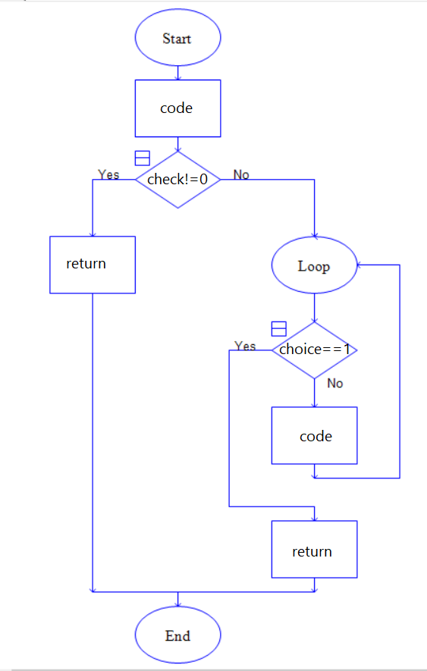
VOID EDIT_PASSWORD()
INTRODUCTION

Slide 16
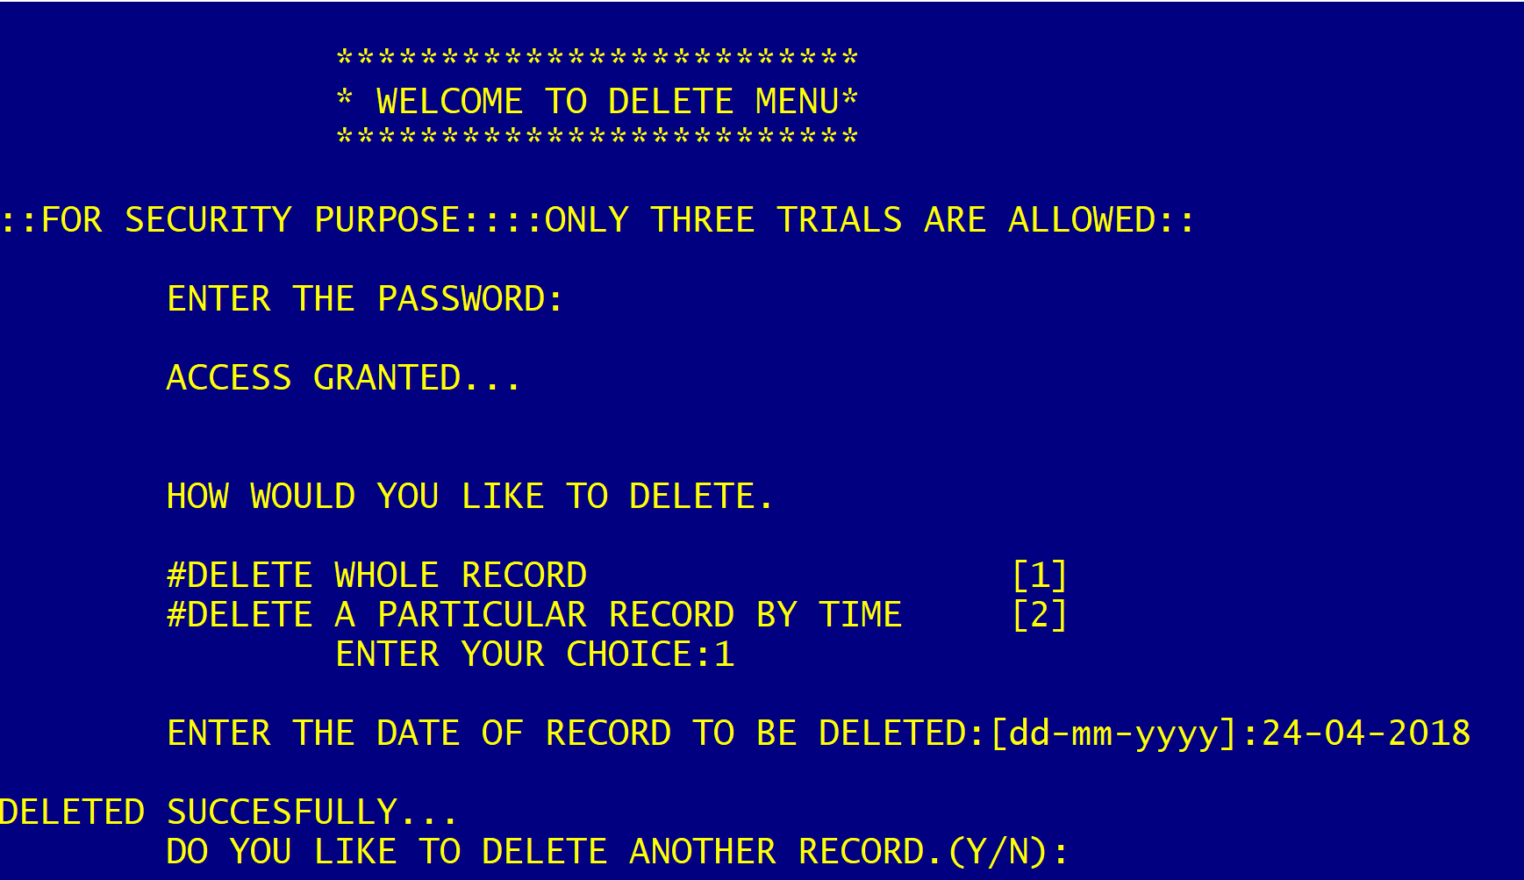
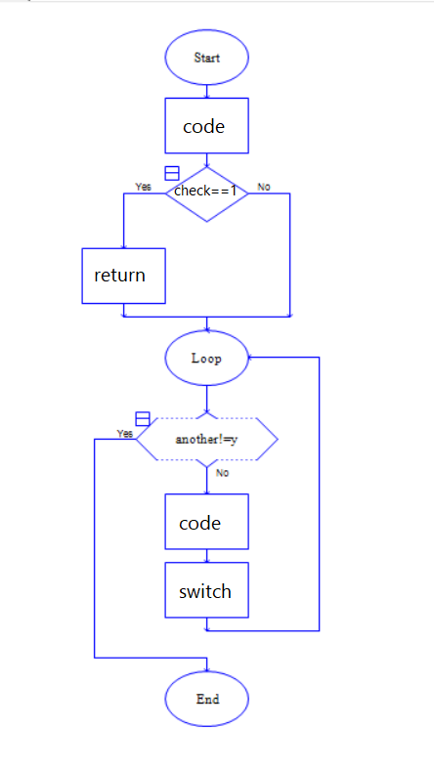
VOID DELETE_RECORD()
INTRODUCTION

Slide 17
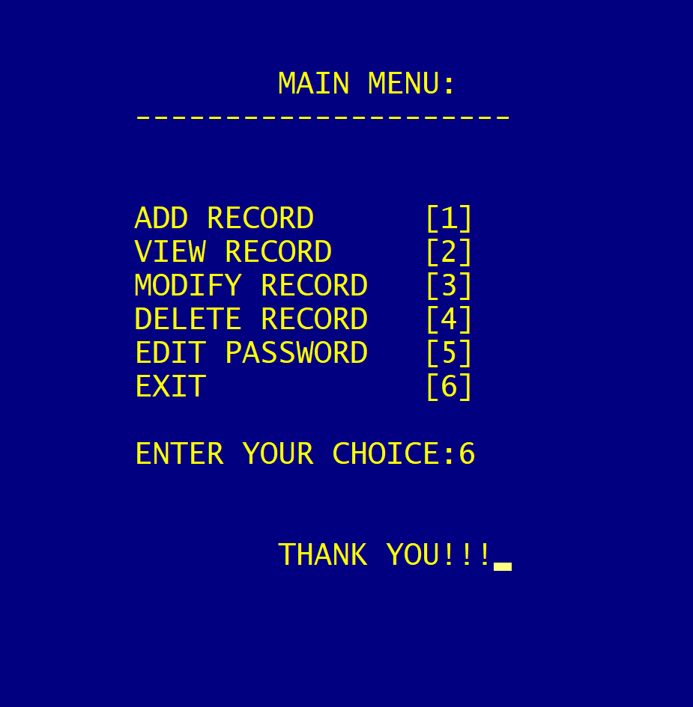
EXIT
INTRODUCTION

Slide 18
ADVANTAGES OVER TRADITIONAL SYSTEM
INTRODUCTION
User can add their daily details safely and it’s not time consuming.
Each section contains high security so there is no chance of data loss.
There’s maximum privacy to the recorded files.
This System makes easy to store daily records. Unlike traditional diary maintaining methods which are more tedious, time consuming and prone to error.

Slide 19
Conclusion
Application was deployed successfully in device & it give good result as per expectations.
Password protected personal dairy very useful to professional person for any instance.

Slide 20
THANK YOU!!!
INTRODUCTION

